Slide 1

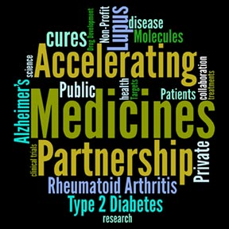

Summit 2015
Models of Collaboration and Open Science
Accelerating Medicines Partnership for Alzheimer’s Disease
Suzana Petanceska PhD
National Institute on Aging

Slide 2
Phase III Randomized, Double-blind, Placebo Controlled, Clinical Trials for AD:
Agent Target/Mechanism Outcome
Atorvastatin HMG CoA reductase Negative
Dimebon Mitochondrial function Negative
Semagacestat Gamma secretase Negative
NSAIDs Inflammation Negative
Phenserine Cholinesterase/Amyloid Negative
Rosiglitazone PPAR gamma agonist Negative
Simvastatin HMG CoA reductase Negative
Tarenflurbil Gamma secretase Negative
Xaliproden Serotonin antagonist Negative
Bapineuzumab amyloid beta (passive immunization) Negative
Solanezumab amyloid beta (passive immunization) Negative*
IVIG amyloid beta (passive immunization) Negative
Failure due to lack of efficacy or unforeseen toxicity.

Slide 3
Total estimated worldwide cost of dementia was $604 billion in 2010.
Absent effective interventions to prevent or delay onset, the social and economic burden of dementia is likely to GROW 3-FOLD in the next 40 years.
  From 44 million worldwide now, to ~ 135 million in 2050

Slide 4

We are targeting the wrong pathophysiological mechanisms
Drugs do not engage with the intended target
Interventions are started at the wrong stage of the disease
Lack of translatable pharmacodynamic biomarkers
Poor predictive power of preclinical efficacy testing in animal models
Complexity of disease
Complexity of drug action

Slide 5
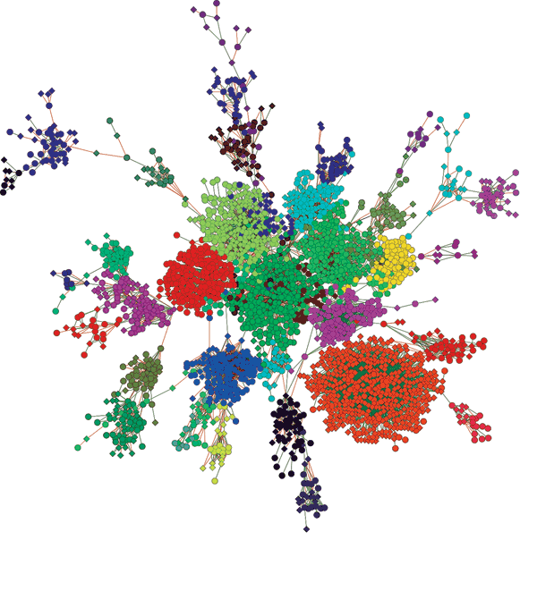
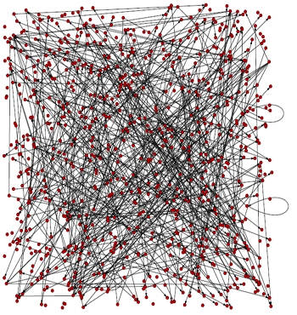
Multiple Etiologies
Multiple Prodromal Phenotypes
Multiple Progression Trajectories
Alzheimer’s Disease
Alzheimer’s
Genetics
Genetics
n
Disease progression
n
Disease modifying
therapy
Healthy
State
Disease
State
Environment
Environment

Slide 6
GOVERNMENT-INDUSTRY-NON PROFIT
A PRECOMPETITIVE PARTNERSHIP FOR KNOWLEDGE CREATION

Slide 7






























Industry members
Type 2 Diabetes
RA, SLE & related
Government members
Non-profit members
Managing Partner

Slide 8



Target Discovery
and Preclinical Validation
Biomarkers
~2,500 brains
Clinical
Pathologic
Genomic
Epigenomic
RNAseq
Proteomic
tau PET imaging
novel fluid biomarkers
Predictive Modeling
A4 DIAN API-ApoE4
Data Integration
Experimental Validation
AMP-AD
Knowledge
Portal
Secondary Prevention Trials
anti-amyloid treatment
Rapid and Broad Sharing of Data
Icahn School of Medicine
NY Stem Cell Foundation
Broad Institute
Rush University
Emory University
U Florida
ISB
Mayo Clinic
UCLA

Slide 9

First public data release: March 4, 2015
AMP-AD Partner
AMP-AD
Knowledge Portal
AMP-AD CollaborativeWorkspace
Data
Analyses
Results
AMP-AD Partner
Quarterly
Data Depositions
Public space
AMP-AD Partner
  -Data released as soon as QC is completed
  -Open and Controlled Access
AMP-AD Partner
  -No publication embargo imposed on
  the use of data after they have been
  made available through the public portal
Additional
Contributors
Consortium Space
https://www.synapse.org/#!Synapse:syn2580853
Notes:
Overall structure.
Place for all to collaborate
Place for individual groups to share
Public place.

Slide 10



Data Being Generated by the
AMP-AD Target Discovery Consortium
systems
perturbations
data types
human
mouse
drosophila
iPSC
RNA-seq
Whole exome
WGS
methylation
miRNA
proteomics
phenotypic measurements
shRNA
compounds
RNAi
X
X

Slide 11
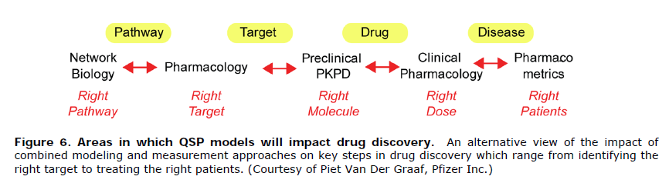
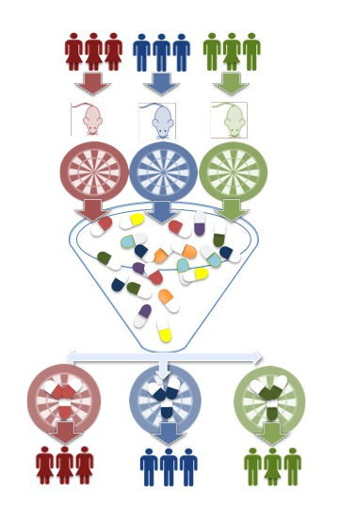
Laying the Foundation for Precision Medicine for AD
Alzheimer’s Disease
n
n

Slide 12
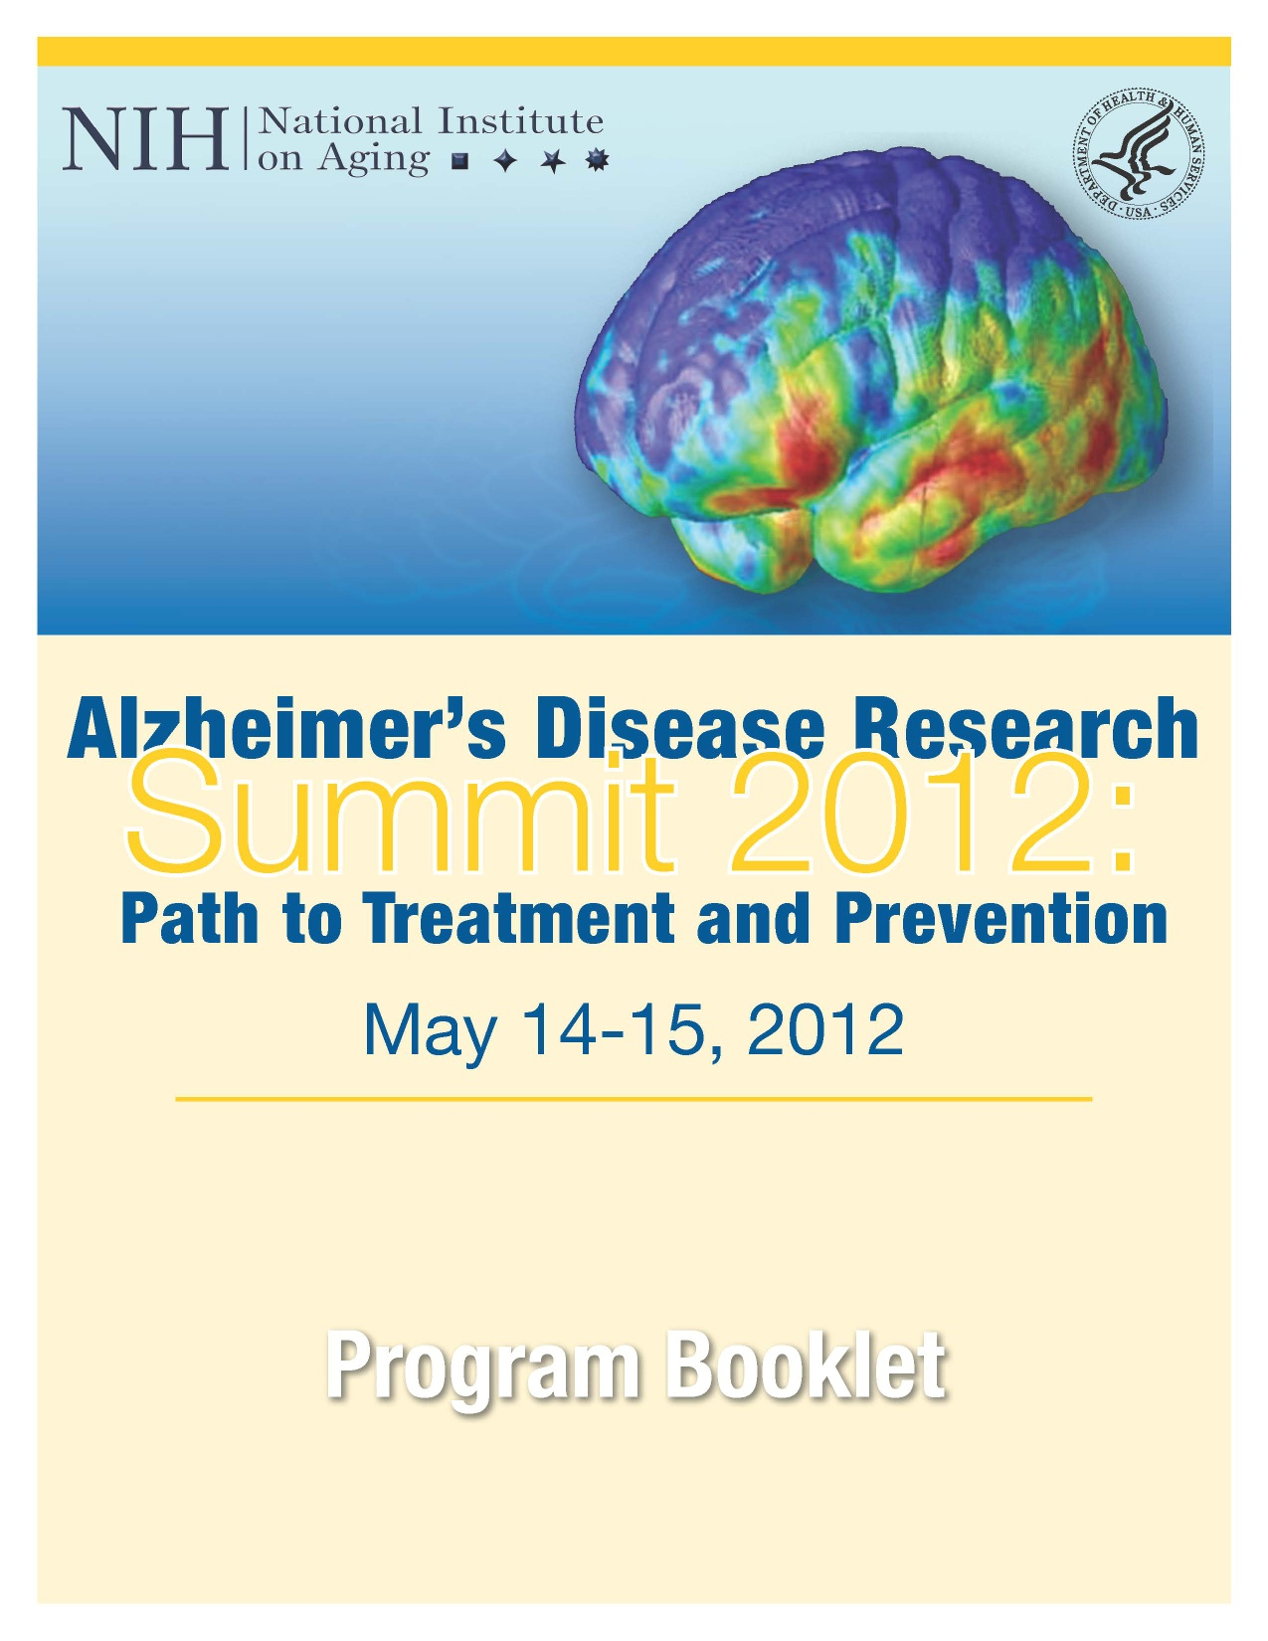

NIH AD Research Summit:
Path to Treatment and Prevention
May 14-15, 2012
Feb 9-10, 2015
Goal: To formulate a blueprint for a new integrated, translational research agenda that will enable the development of effective therapies (disease modifying and palliative) across the disease continuum for the cognitive as well as neuropsychiatric symptoms of Alzheimer’s disease and to identify the resources, infrastructure and public private partnerships necessary to successfully implement this research agenda.

Slide 13
2012/2015 AD Summit: Some Overarching Messages
Recognize the heterogeneity and the multifactorial nature of the disease.
Employ new research paradigms such as systems biology and systems pharmacology.
Enable rapid and extensive sharing of data, disease models, and biological specimens.
Develop computational tools and infrastructure for storage, integration, and analysis of large-scale biological and other patient-relevant data.
Build new multidisciplinary translational teams and create virtual and real spaces where these teams can operate.
Support and enable open science.
Develop new precompetitive public-private partnerships.
Change academic, publishing, and funding incentives to promote collaborative, transparent, and reproducible research.

Slide 14
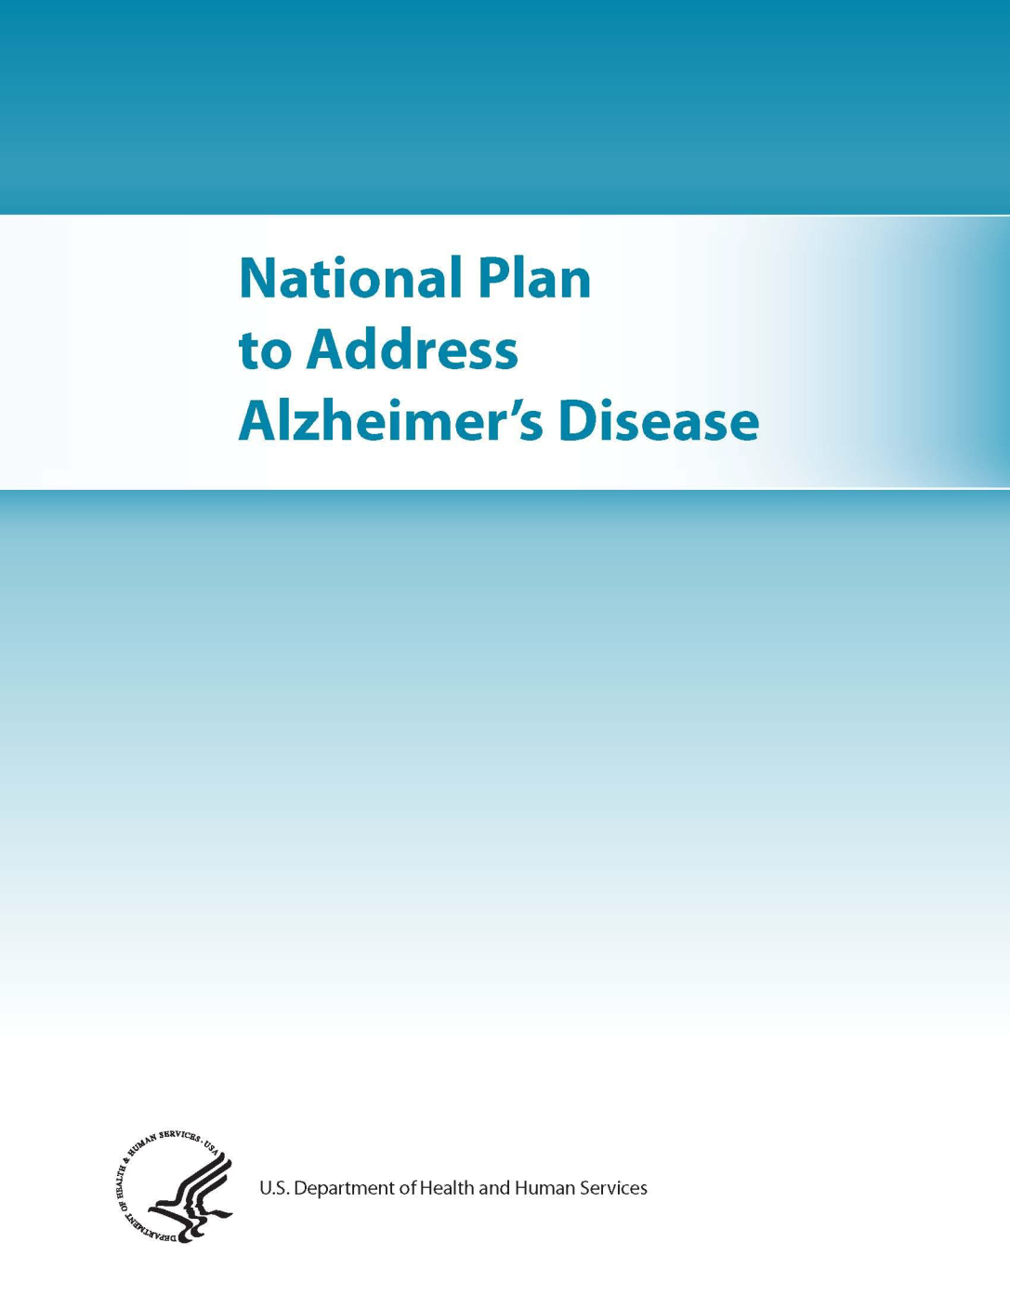
National Plan Goals:
1. Prevent and effectively treat Alzheimer’s Disease by 2025.
2. Optimize care quality and efficiency.
3. Expand supports for people with Alzheimer’s disease and their families.
4. Enhance public awareness and engagement.
5. Track progress and drive improvement.

